Slide 1
Kindness 101
Grace Foxwell Murdock
Wicomico grows Kindness
SBY Secretary of Kindness

Slide 2
Kindness reduces bullying.
https://www.stopbullying.gov/blog/2017/07/26/can-kindness-overcome-bullying.html

Slide 3
Kindness increases self-esteem.
https://youtu.be/ir0B0pnfzY0

Slide 4
Kindness is a large part of being “nice.”
https://youtu.be/1pEabk_pUiU

Slide 5
Role models play a huge part for others deciding to practice kindness.
People and/or initiatives and resources to follow on social media:
http://www.onemillionactsofkindness.com/
www.loveglassesrevolution.com
www.thegoodcards.com
www.thekindnessrocksproject.com
www.lifevestinside.com
www.kindnessdiaries.com
www.randomactsofkindness.com
www.worldkindnessusa.com
www.fallforwardacrossamerica.com

Slide 6
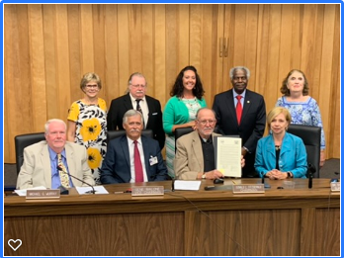
Dr. Hanlin and the Board of Education signed a resolution
to support World Kindness USA on July 9th, 2019.
https://www.facebook.com/DelmarvaLife/videos/907639679604254/

Slide 7
KINDNESS IS A CHOICE.
Kindness is the social glue that
connects individuals and holds a
community together.
Your classes will be small communities. Try kindness.
Wishing you much success for your school year!

Slide 8
RESOURCES
https://lesley.edu/article/6-ways-educators-can-prevent-bullying-in-schools
https://www.edutopia.org/blog/teaching-kindness-essential-reduce-bullying-lisa-currie
https://www.teachthought.com/pedagogy/8-reasons-for-teaching-kindness-in-schools/
https://www.rmccharity.org/bullying-prevention-institute/resources/facts-and-laws/

