Slide 1
Plan B: Responding to misbehavior
Review of Supports
Teaching with Love and Logic
Addressing specific Behaviors
Documentation

Slide 2
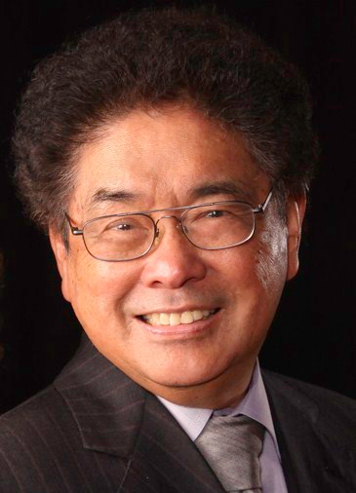
“It is much easier – and far more effective – to monitor and correct procedures than to institute tighter discipline.”
Harry Wong

Slide 3
Wicomico County Teaching Observation and Evaluation Rubric
Note!
Domain 2: The Classroom Environment
 | LEVEL OF PERFORMANCE
Component | Ineffective | Developing | Effective | Highly Effective
2a: Creating an Environment of Respect and Rapport | Classroom interactions among the teacher and individual students are not respectful and do not reflect caring and sensitivity to students’ cultures and levels of development. | Classroom interactions among the teacher and individual students are generally respectful and free from conflict but may be characterized by occasional displays of insensitivity or lack of responsiveness to cultural or developmental differences among students. | Classroom interactions among the teacher and individual students are respectful and reflect caring and sensitivity to students’ cultures and levels of development. The teacher addresses and intervenes when conflicts or misunderstandings occur. | Classroom interactions among the teacher and individual students are respectful and reflect caring and sensitivity to students’ cultures and levels of development. The teacher addresses and intervenes when conflicts or misunderstandings occur. The teacher takes proactive measures to achieve civility among members of the class.
2b: Establishing a Culture for Learning | The teacher does not convey enthusiasm for the content and is not working toward establishing high expectations for learning. | The teacher conveys enthusiasm for the content and is working toward establishing high expectations for learning. | The teacher conveys enthusiasm for the content and encourages students’ active participation in their learning. The teacher establishes and maintains high expectations for learning. | The teacher conveys enthusiasm for the content and encourages students’ active participation in their learning. The teacher and students work together to establish and maintain high expectations for learning.
2c: Managing Classroom Procedures | The teacher does not manage classroom routines and procedures. | The teacher establishes inefficient classroom routines and procedures resulting in a loss of instructional time. | The teacher establishes and maintains classroom routines and procedures to minimize the loss of instructional time. | The teacher maximizes instructional time by establishing and maintaining classroom routines and procedures for seamless transitions, handling of supplies and performance of non-instructional duties.
2d: Managing Student Behavior | The teacher does not establish student behavioral expectations. The teacher’s response to student behavior is inappropriate. | The teacher has made an effort to establish student behavioral expectations. The teacher tries, with inconsistent results, to monitor and respond to student behavior. | The teacher establishes clear student behavioral expectations aligned with county policy. The teacher’s management of student behavior is sensitive to individual student needs and respectful of the students’ dignity. The teacher’s response to student behavior is appropriate. | The teacher establishes clear student behavioral expectations aligned with county policy. The teacher’s management of student behavior is proactive, sensitive to individual student needs and respectful of the students’ dignity. The teacher’s response to student behavior is appropriate.

Slide 4
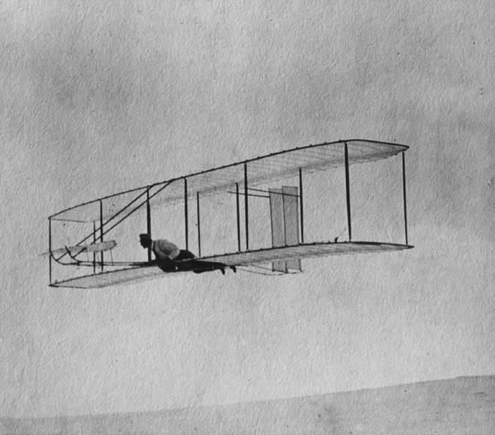
You Can build the plane while flying it!
This Photo by Unknown Author is licensed under CC BY-SA

Slide 5
You have many supports!
Wicomico County Code of Conduct
Best Practices Guide: Promoting Achievement in Safe and Productive Classrooms and Schools
Graduated Responses to Behavior Problems
Behavior Toolkit (XIA links found on your desktop)
Teaching with Love and Logic
New teacher mentor and ongoing support and professional development

Slide 6
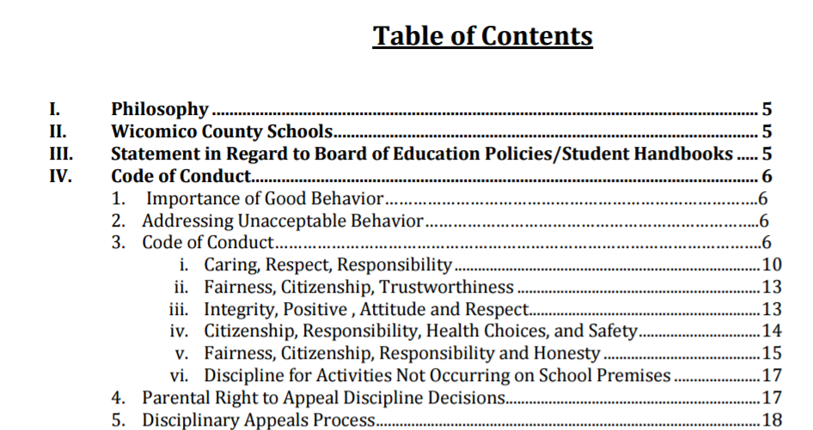
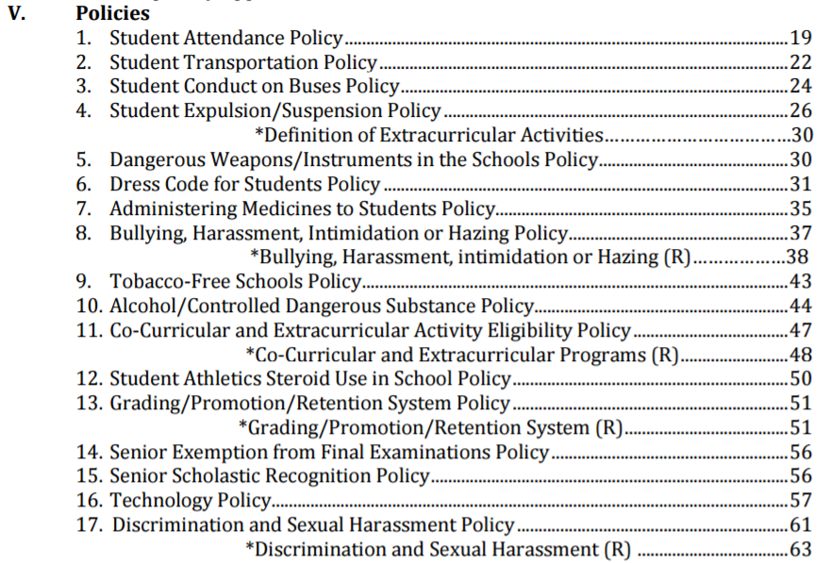
Policies = Binding
www.wcboe.org

Slide 7
Best Practices Guide
Part One – Practices that support a positive learning environment
Part Two – Instructional practices and classroom management
Part Three – School-wide discipline interventions and consequences - and the classroom portion of the Progressive Discipline Plan
Part Four – Ways schools can support the practices
Created in 1996 with ongoing efforts and revisions by various behavior management teams throughout the county
Recently reviewed and edited with support from Dr. Peter Leone at the University of Maryland and administrative teams at the 2018 Leadership Academy in Wicomico county

Slide 8
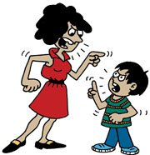
Best Practices Guide: Part 3
Is this your parents’ discipline?

Slide 9
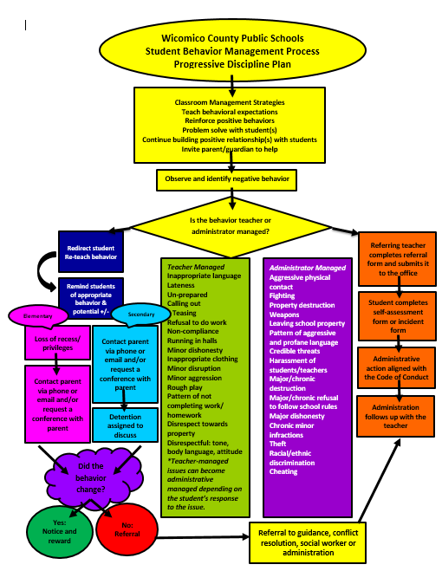
Progressive Discipline Model of Consequences for Misbehavior
X2
What are teachers’ responsibilities in the progression of consequences?

Slide 10
Basic Steps of Progressive Discipline
Use clarity, consistency, and patience to teach, reinforce, and re-teach procedures and behavioral expectations.
Hold a short, private conversation with a student to determine what led to the misbehavior(s). DOCUMENT.
Try additional interventions, as needed (toolkit). DOCUMENT.
Make parent/guardian contact…as best you can. DOCUMENT.
Hold a detention to talk and regroup.
DOCUMENT.

Slide 11
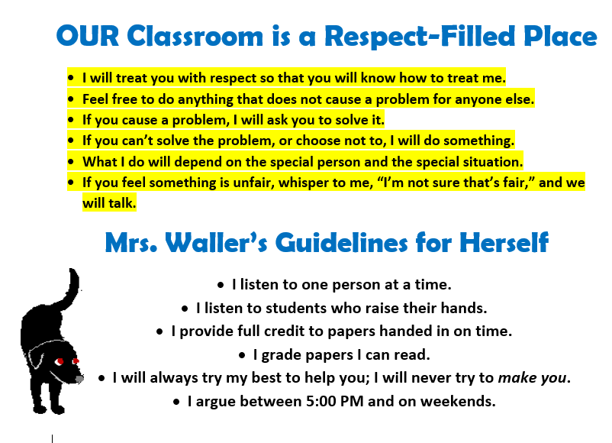
The Language of Love and Logic

Slide 12
Behavior Toolkit of Strategies
Found in desktop icons/applications
Interventions to modify behavior before an office referral is necessary
Follow the graduated progression

Slide 13
The Four Goals of Misbehavior
1. Attention “Look at Me” - ATT
2. Power “Let’s Fight/You Can’t Make Me” - POW
3. Revenge “I’ll Get Even” - RVG
4. Avoidance of Failure “Leave Me Alone” - AVF

Slide 14
Responding to Misbehavior on Day One
Common first-DAY and first-WEEK
student behaviors:
Coming to class late - POW, ATT, AVF
Entering class loudly – ATT
Talking while you’re giving directions – ATT, POW, AVF
Wandering around the room – ATT, POW, AVF
Not having materials and asking to leave class to get them - AVF
Sitting by friends – ATT, POW
Moving furniture – POW, ATT
Charging phones – POW, ATT
Eating or drinking in class – ATT, POW
Casual cussing – ATT
Outbursts of laughter – ATT, AVF
Inappropriate questions – ATT, AVF, POW, RVG
And more!

Slide 15
Use These Moves
1. Ignore, redirect, model appropriate behavior
The Look - Others
Proximity
Gesture
2. Remind student of appropriate behavior; identify positive and
negative consequences
- ___________ is a problem for me because it’s distracting to your
classmates and to me. If you can get back on track, you’ll be able to get
your work done on time. If not, I will do something.

Slide 16
Opposing Opinions
Strong Emotions
Crucial Conversations
High Stakes

Slide 17
Student Conference: a time for respect and caring
- Here’s what I observed you doing…
- So, here’s what I did…
- I observed this response…
- Help me understand what’s going on…
LISTEN!
- Value the student’s response.
- Explain what he/she needs to do to be successful.
- Ask the student if he/she needs something more from you to be successful.
- Assure the student that you know he/she will make a
change and will get a fresh start.
- Explain progressive consequences to student.
DOCUMENT YOUR INTERVENTIONS

Slide 18
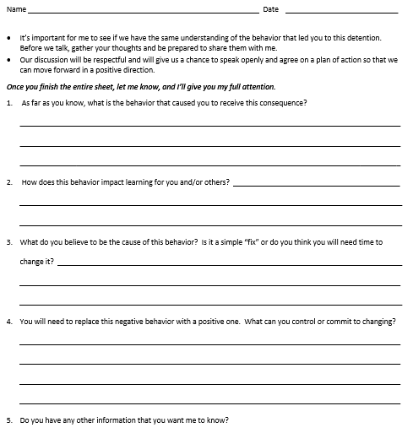
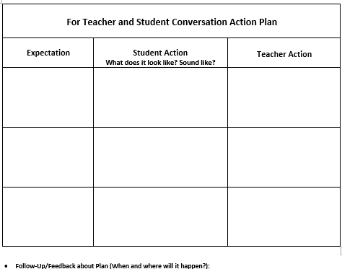
Hold a Detention to Get Back on Track

Slide 19
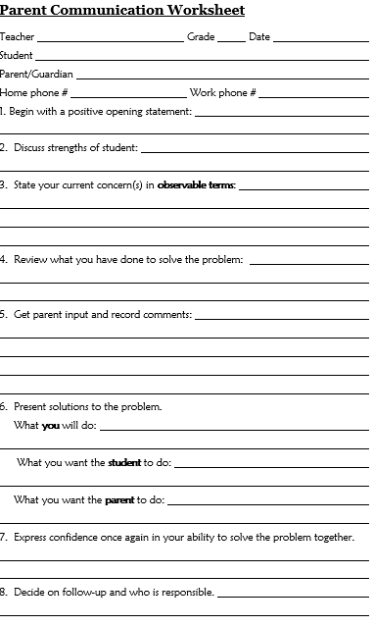
Contacting Parents

Slide 20
Documenting Your Interventions

Slide 21
Poll Everywhere
The behavior most challenging for me to address is…

Slide 22
Discuss Scenarios
Utilize your resources to work through some behaviors that stump you.

Slide 24
Some Students Require More Love than Logic…
TEACHER refers students to…
Counselor
Student Services Team
Student Behavior Team
Social skills training?
Mental health services?
Conflict resolution
Restorative justice practice

Slide 25
It’s helpful to survey students’ interests and offer choices where instruction is concerned. It’s also necessary to listen to students’ complaints, at appropriate times. Shutting down students’ feelings will backfire.
Go in with patience. You need much more than you think!
Sometimes it’s best to NOT react to students’ comments – you might even ignore them completely. You can also respond with, “Hmm.”
Let your non-response do the talking.
Understand that kids are a work in progress - like the rest of us!
Have a talk with students about equity vs. equality.

Slide 26
Meet New Colleagues!
School | Representative(s)
Bennett Middle | Nicole Hansen
James M. Bennett High | Nancy Turner
Mardela Middle and High | Shane Noonan
Parkside High | Brigette Filer and Mary Stoltzfus
Salisbury Middle | Administrative team
Wicomico High | Amanda Raniolo
Wicomico Middle | Alison Wysocki

